Slide 1
Ideas For Final Project

Slide 2
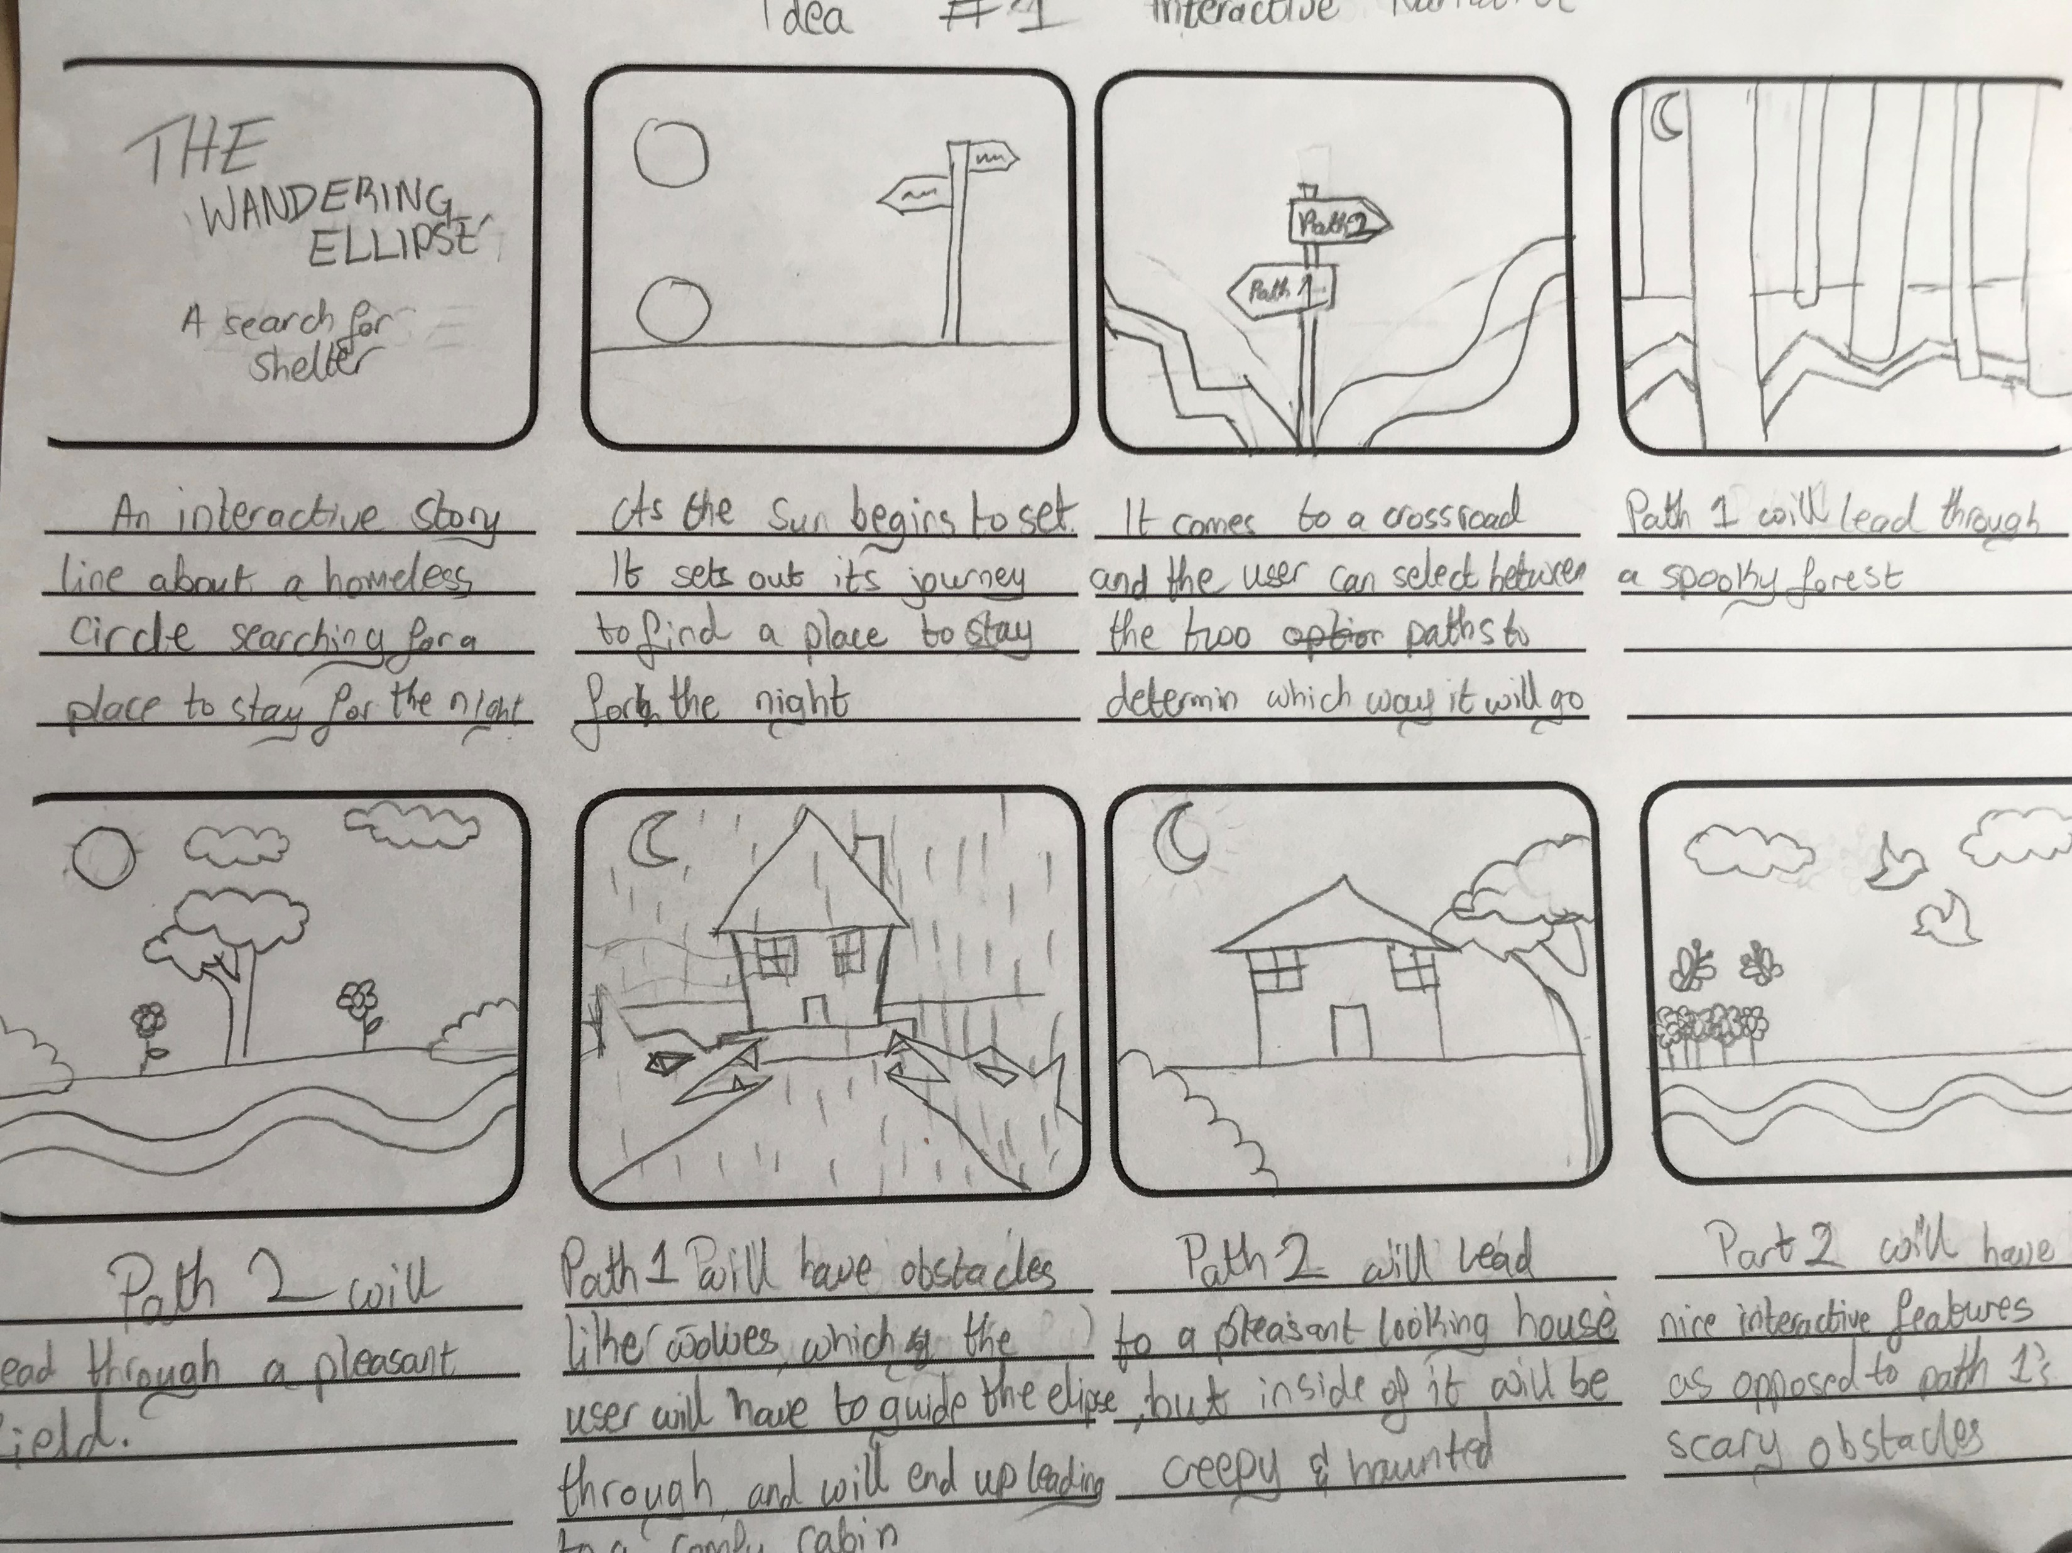
Idea #1 – The wandering Ellipse
Interactive narrative
Design inspired by the Nokia game Bounce tales
https://www.youtube.com/watch?v=8e7XtdrtuE0
Uses user input

Slide 3
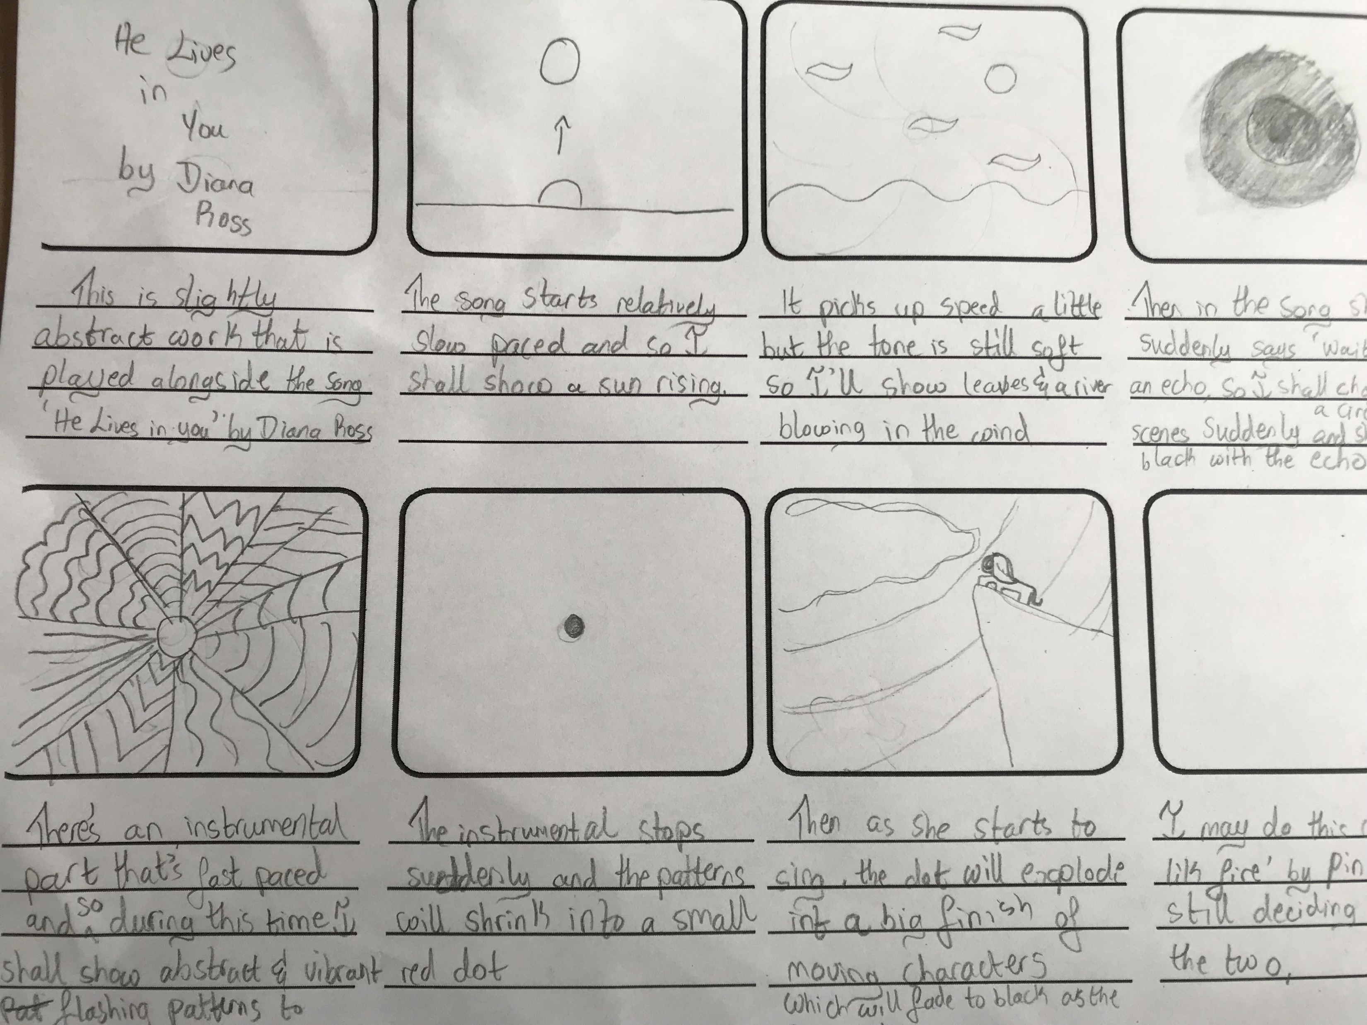
Idea #2 – Music video
Choose Your own adventure option
Inspired by Joshua Davis, bound
Should look something like this https://vimeo.com/257161749
Will either use the song ‘Just like fire’ by Pink or ‘He Lives in You’ by Diana Ross.
Does not use user input but
Changes with time.

Slide 4
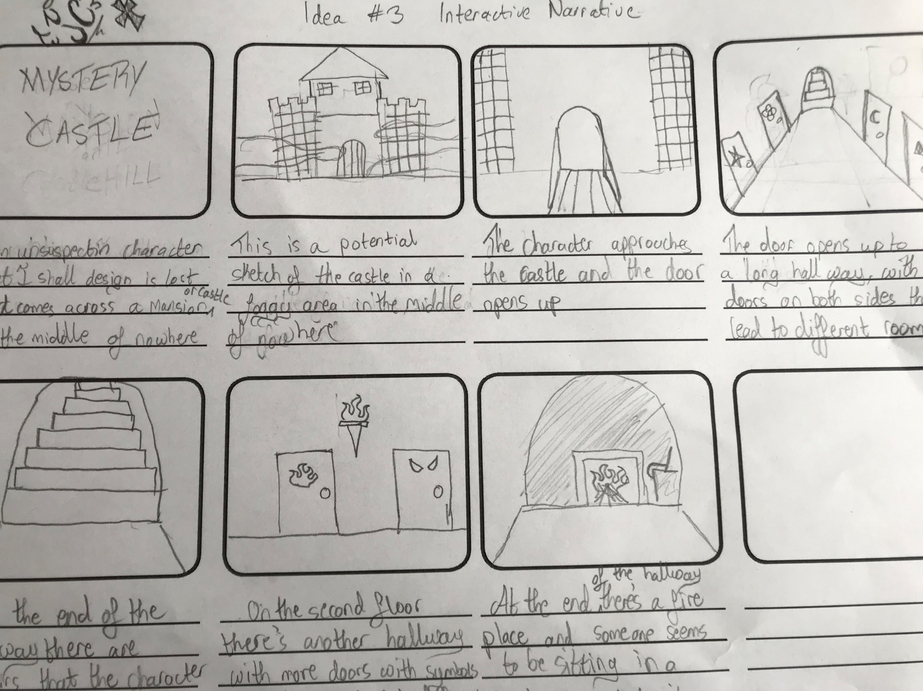
Idea #3 – Mystery Castle
Interactive narrative
Inspired by the fictional Hogwarts castle.
https://www.youtube.com/watch?v=znQDRRbhzh4
Uses user input

Slide 5
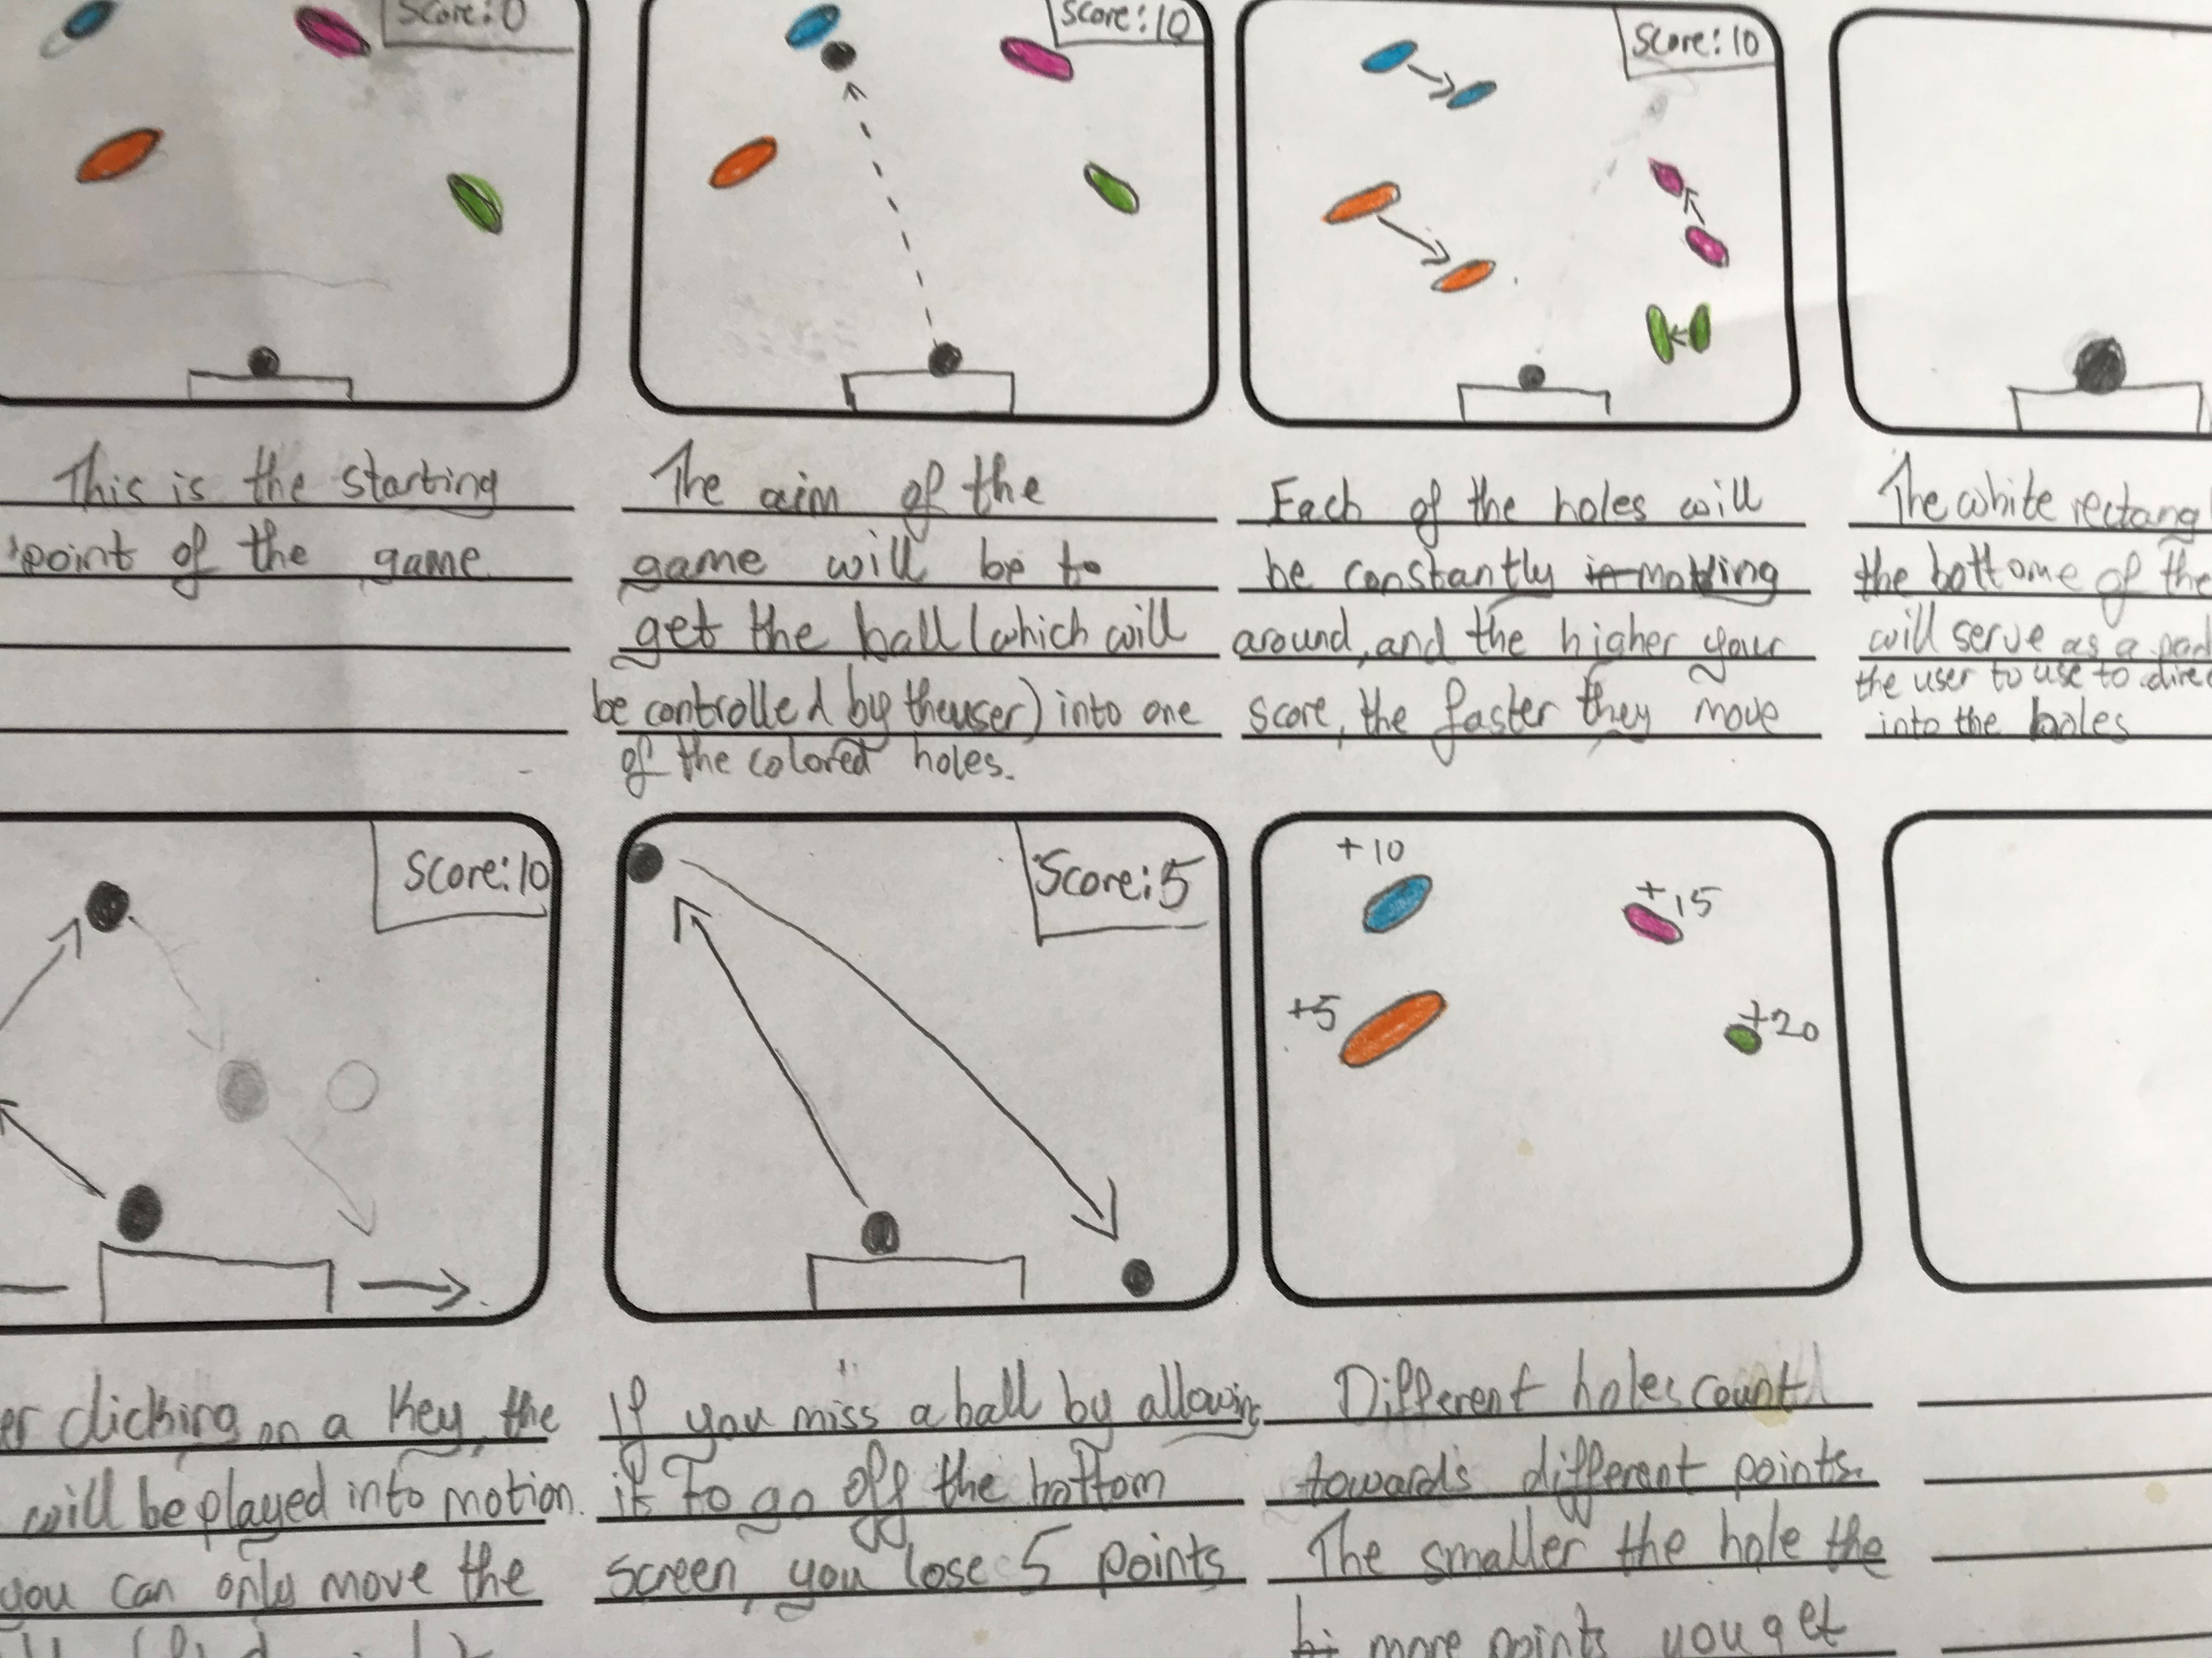
Idea #4 – Into the hole
High score (game)
Inspired by the game super breakout by Atari
https://www.youtube.com/watch?v=CSqEFei_zS4

